Slide 1
COMPUTER SCIENCE ART INTEGRATED PROJECT
Supermarket MANAGEMENT SYSTEM
By Dhruv Rajeshkumar Shah
Anirudh Satish

Slide 2

DELHI PUBLIC SCHOOL BANGALORE NORTH
This is to certify that the following students of class XII -
Student name - Dhruv Rajeshkumar Shah
Board roll no - 18608480
Student name - Anirudh Satish
Board roll no - 18608464
have successfully completed Project Work titled SUPERMARKET MANAGEMENT SYSTEM
Under the supervision and guidance of
Mrs Uzma Fathima
During the academic year 2020-21for the fulfilment of internal assessment
Sign and designation

Slide 3
ACKNOWLEDGEMENT
We would like to express our special thanks of gratitude to the management and principal of Delhi public school Bangalore north for giving us this opportunity to do this project. We would also like to thank our class teacher and computer teacher Mrs. Uzma Fathima Ma’am without whose guidance we couldn’t have finished this project.
Lastly, we would also like to thank our parents who not only supported us but also provided us with the necessary resources for us to complete the project in the given time frame.

Slide 4

TABLE OF CONTENTS
Introduction to the project
Project Design
Output Snapshots
Bibliography

Slide 5


INTRODUCTION
This is a proposed integrated super market management system that aims to support the needs of immense amount data handling in a Supermarket on a day to day basis. It is user-friendly and simple yet a very powerful tool that can help Supermarket store owners, managers and employees to help make tedious tasks such as product management, employee management, order management, bill management, profit statistics calculation and billing much easier.
This software uses python for front end and processing and mysql and textfiles for backend storage of data.
This is a must have application in all supermarket stores to help them make every tasks more efficient and easier!

Slide 6
HARDWARE AND SOFTWARE SPECIFICATIONS
Both development and implementation of this software requires the same hardware and software specifications.
Hardware requirements-
1. Processors: Intel Atom® processor or Intel® Core™ i3 processor
2. Disk space: 1 GB
3. Operating systems: Windows* 7 or later, macOS, and Linux
Software requirements-
1. Python version 3+ with latest pip installer
2. MySql version 4.1 +

Slide 7
PROJECT DESIGN
Project Modules and Flow Design
The main functions of this software are distributed in these python files according to their utility-
Main- The basic backbone module that integrates the features of all the other modules and runs. The main file that has to be run to access the software.
Setup- The module is executed when user uses the program for the first time. It is used to setup the databases and files.
Menus- Contains functions for all the menus in the program. Integrates all the utility functions and has all the function call statements for performing various tasks.
Databases- Contains all the main database utility functions to view, add, modify and delete records in the database and text files.
Billing system- Contains billing related functions for billing and storage and display of bills. Also contains function for calculating profit statistics.

Slide 8
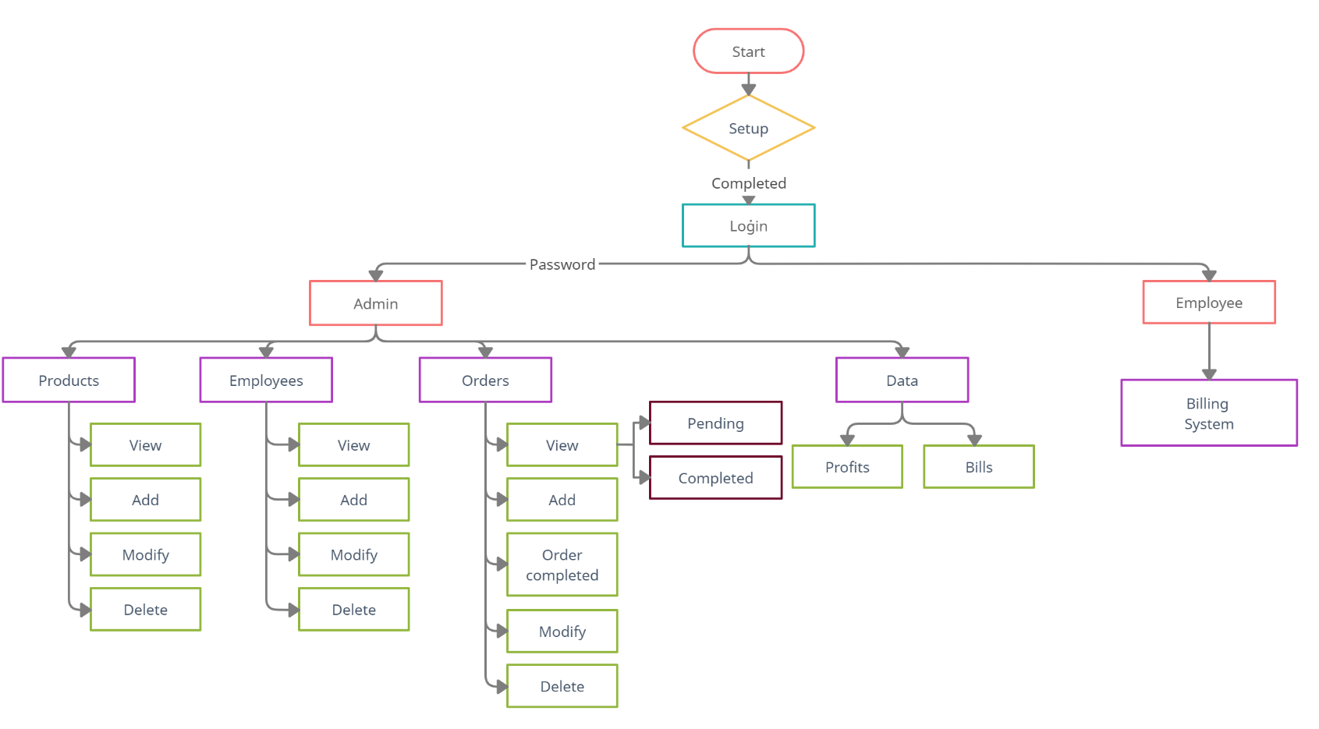
PROJECT DESIGN FlOW CHART

Slide 9
PYTHON LIBRARIES AND FILES
LIBRARIES
This project uses a number of built-in as well as installed libraries and modules for various functions.
Built in-
OS- system(), mkdir(), path()
Used for clearing screen, creating bills directory, checking if files such as smms, sno, completed orders exists.
Datetime- date.today(), datetime.now()
Used to get the current date and time.
Installed libraries-
Art- text2art()
Used for ascii art text for headings.
Mysql.connector- connect(), cursor(), cursor.execute(), cursor.fetchall(), commit()
Used for establishing database connections and database management functions.
Tabulate- tabulate()
Used for displaying data in a tabulated form.

Slide 10
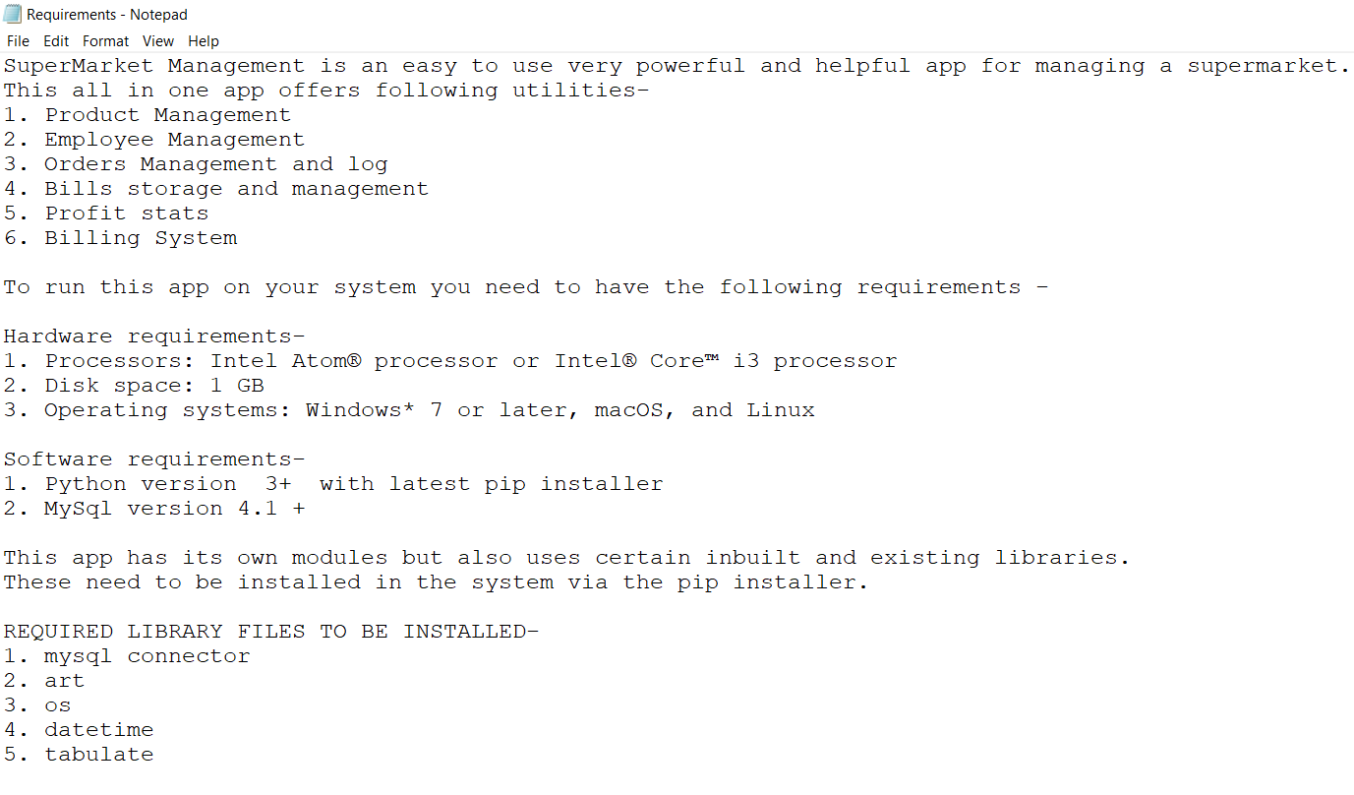
DIRECTORY/FOLDERS
bills- directory/folder created during setup to store bills
FILES
This project uses text files for various purposes such as displaying certain text, storing basic data and password, serial numbers, records and bills. This project has both premade text files which come with the package program and ones that are created after execution.
Premade text files-
Requirements.txt- Used to display the system requirements before setup to ensure all functions work properly
(remains same throughout)

Slide 11
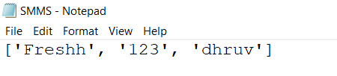
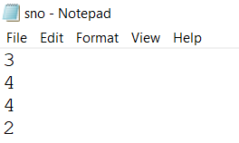
Created after execution-
SMMS.txt- The main text file whose existence determines weather setup is done or not. Stores name of store/database, password for the software and mysql password
sno.txt- Used to store product no, employee no, order no and bill no for automated numbering
completed_orders.txt- Used to store details of completed orders
(is sample, subjected to change)
(is sample, subjected to change)
(is sample, subjected to change)

Slide 12
Database Design Structure
Database Name: Same as the name of the store, provided by the user during setup.
Purpose: It contains all the necessary data which is required to be stored by a supermarket.
Tables used for database/project -
Table 1: PRODUCTS – Stores information about various products in the store.
Table 2: EMPLOYEE – Stores personal details of all employees working in the store.
Table 3: ORDERS – Stores information about pending orders from suppliers.
Table 4: BILLS – Stores information about the bills issued.

Slide 13
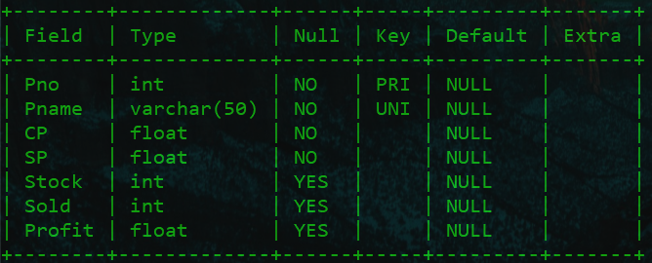
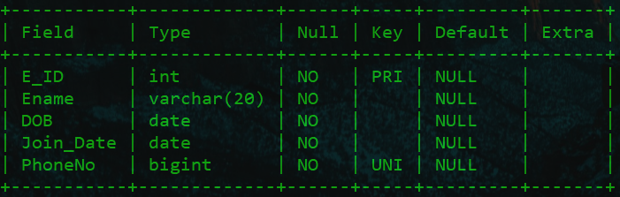
Table 1: PRODUCTS
Table 2: EMPLOYEE

Slide 14
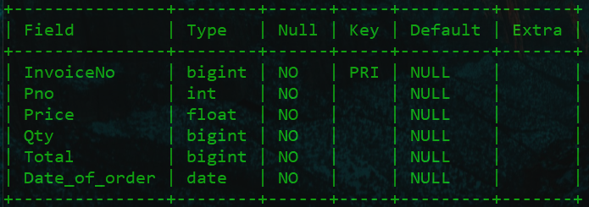
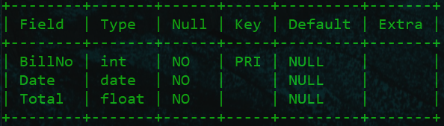
Table 3: ORDERS
Table 4: BILLS

Slide 15
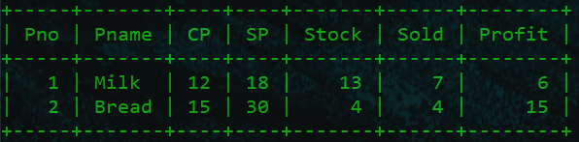
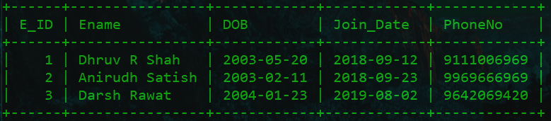
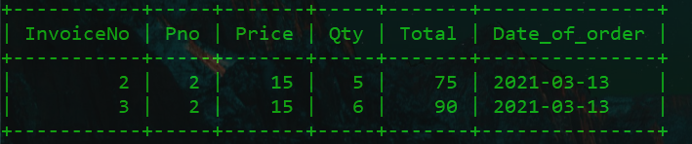
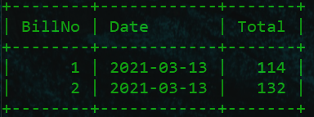
SAMPLE TABLES
Sample products 1: PRODUCTS
Sample products 2: EMPLOYEE
Sample products 3: ORDERS
Sample products 4: BILLS

Slide 16
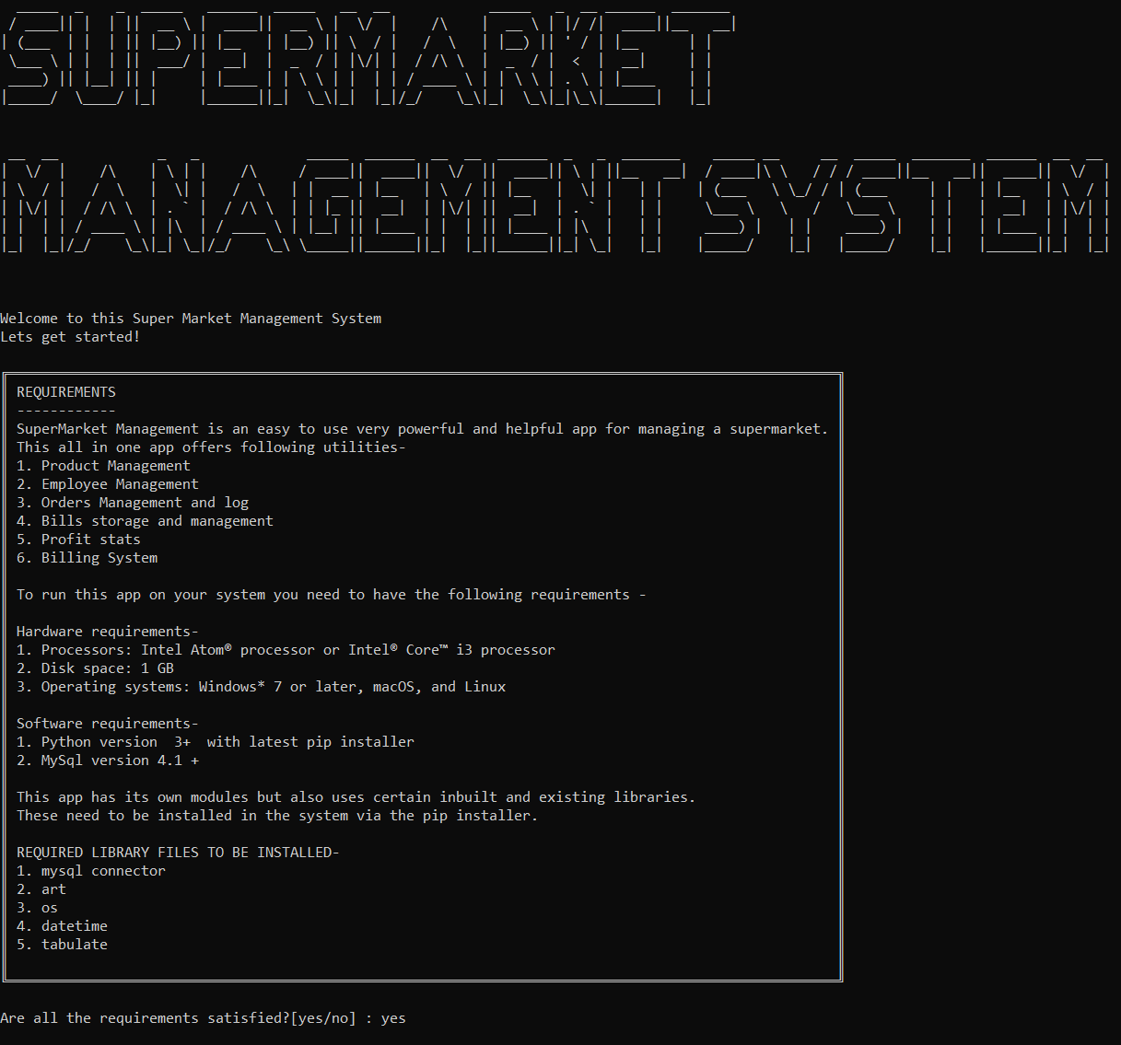
Output snapshots
SETUP SCREEN 1 – Requirements confirmation

Slide 17
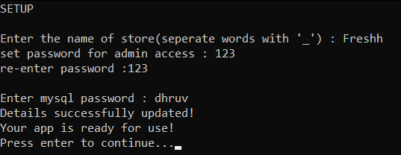
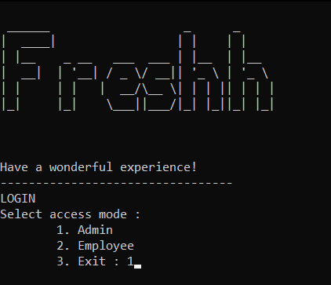
SETUP SCREEN 2 – Login info and password
MAIN MENU SCREEN

Slide 18
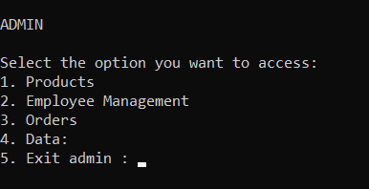
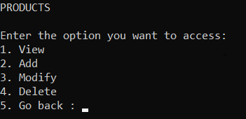
ADMIN MENU
PRODUCTS MENU

Slide 19
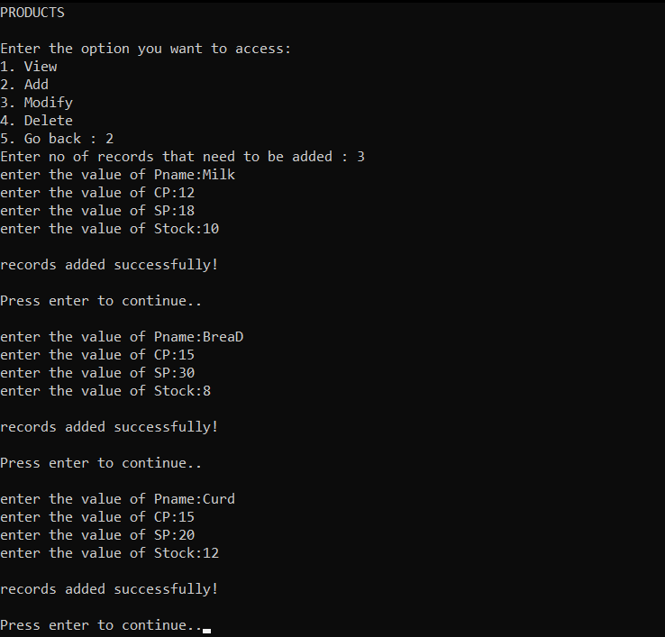
Adding products

Slide 20
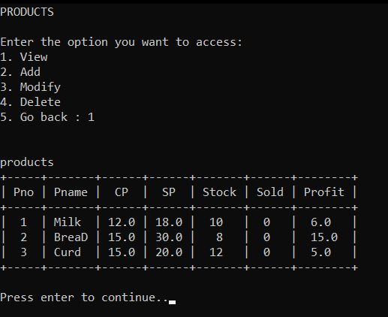
Viewing products

Slide 21
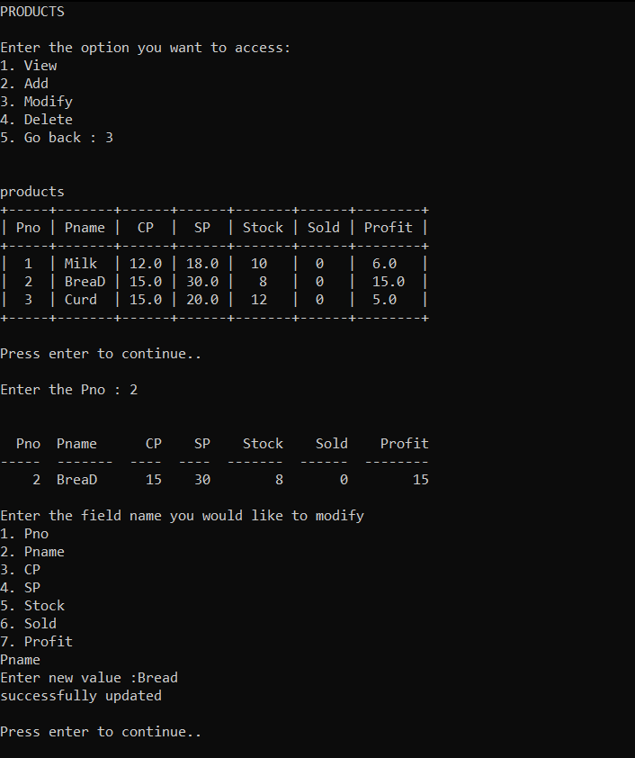
Modifying Products

Slide 22
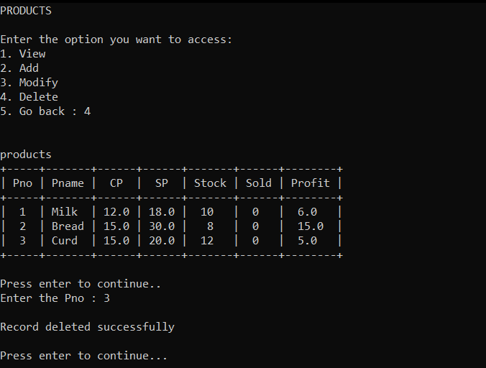
Deleting products

Slide 23
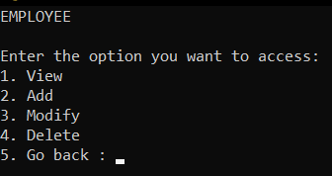
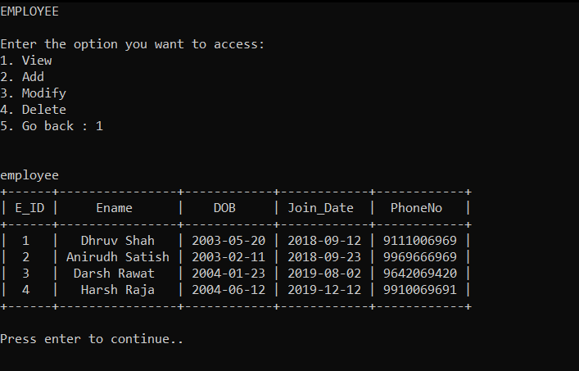
EMPLOYEE MANAGEMENT MENU
Viewing employees

Slide 24
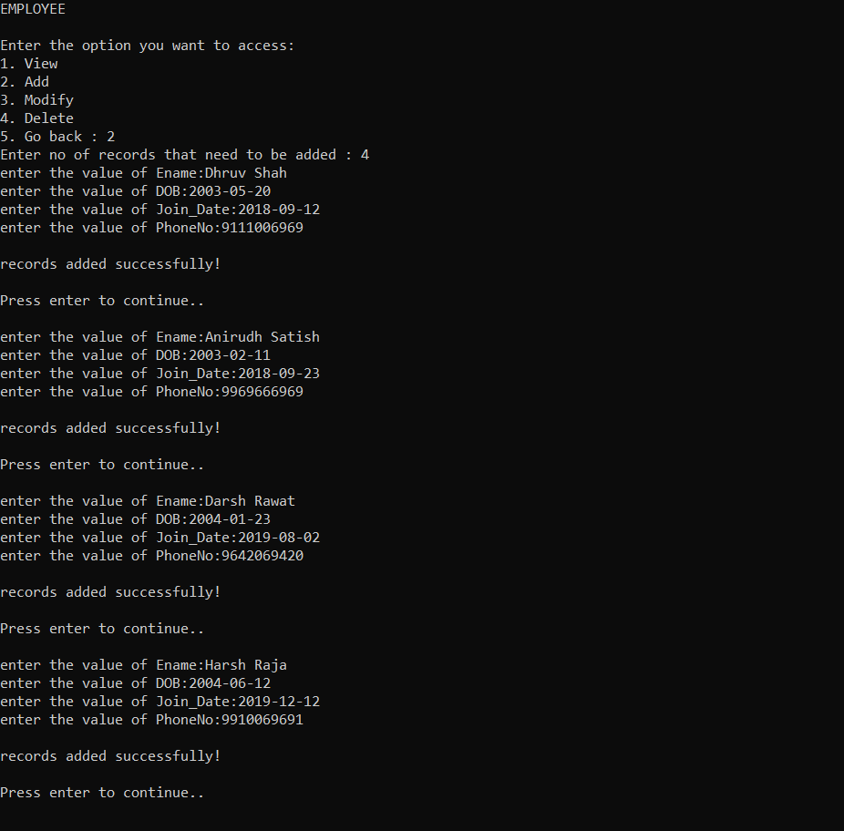
Adding employees

Slide 25
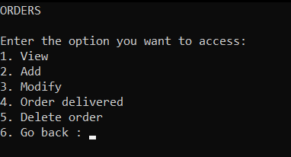
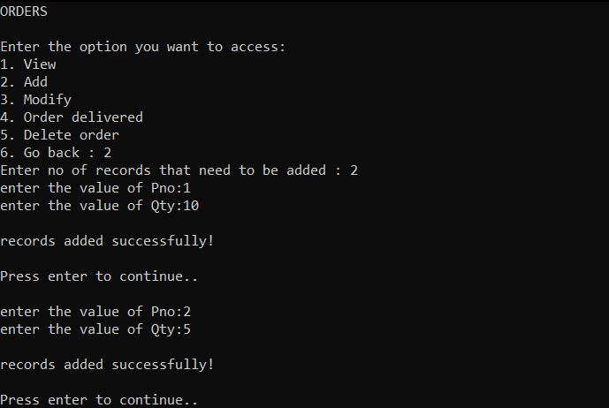
ORDERS MENU
Adding orders

Slide 26
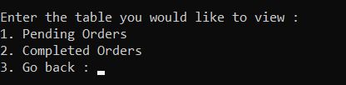
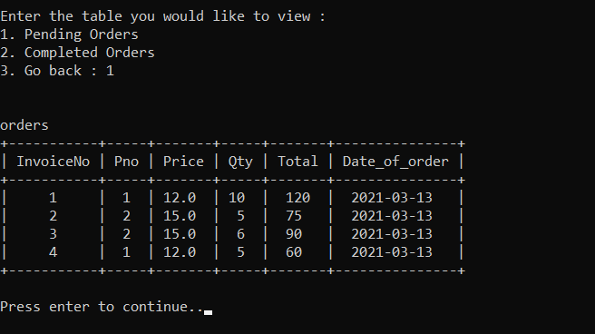
View orders menu
Viewing pending orders

Slide 27
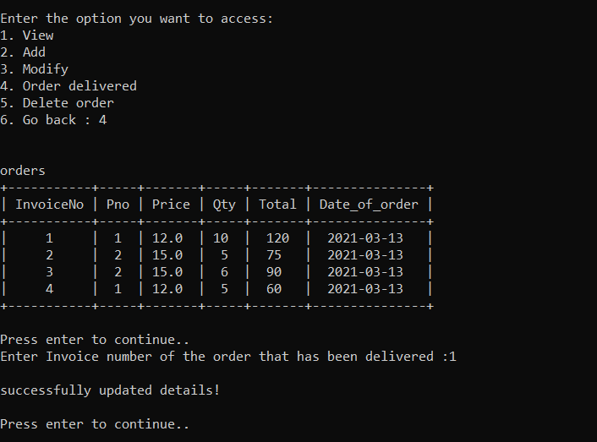
Marking orders delivered

Slide 28
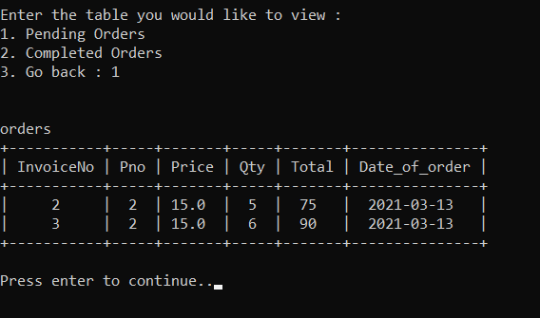
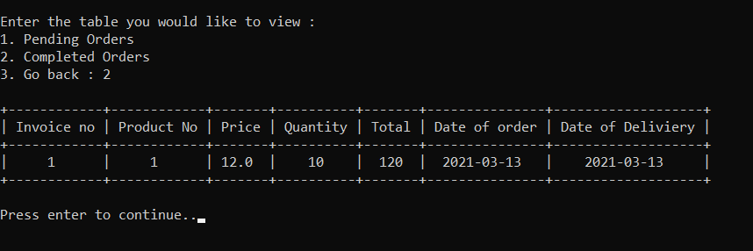
Viewing pending orders after marking completed
Viewing pending orders after marking completed

Slide 29
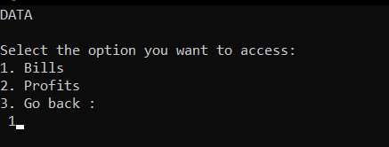
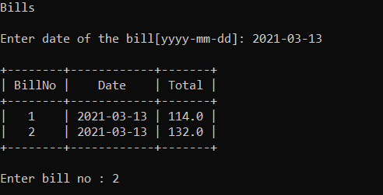
DATA MENU
Viewing bills of specific date

Slide 30
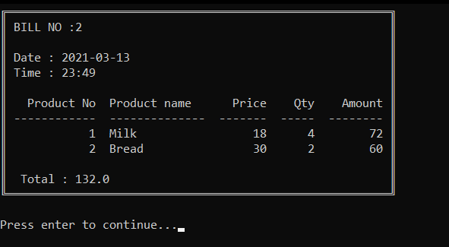
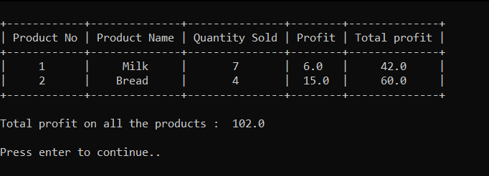
Displayed bill
Profit statistics

Slide 31
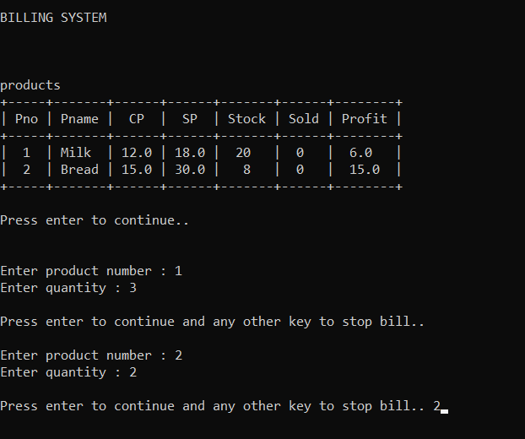
BILLING SYSTEM(Employee)

Slide 32
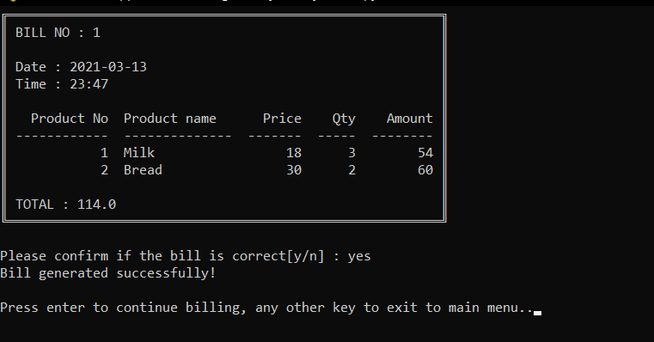
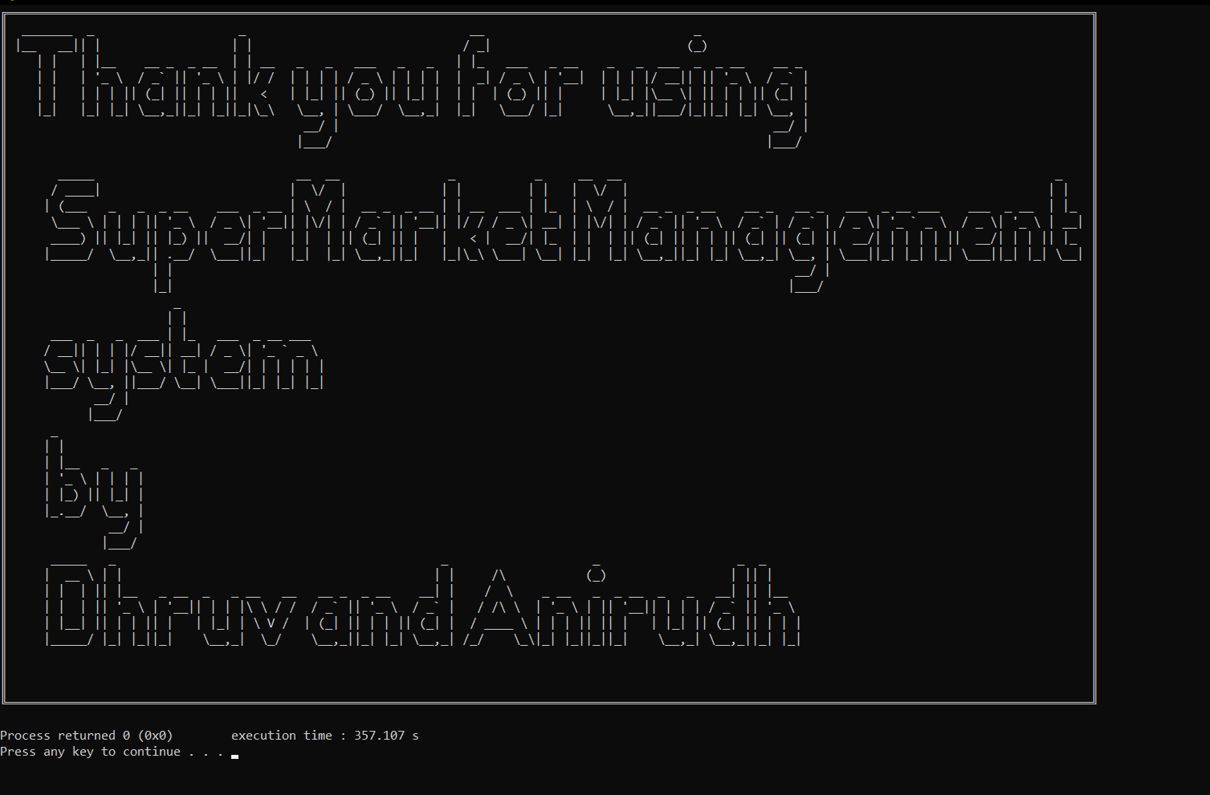
Bill confirmation
END SCREEN

Slide 33
BIBLIOGRAPHY
Sumit Arora’s Computer science with python for class XI and class XII
https://docs.python.org/3/library/datetime.html
https://docs.python.org/3/library/os.html
https://pypi.org/project/tabulate/
https://pypi.org/project/art/

